Slide 1
Collaboration

Slide 2
Content
Collaboration workflows
Pushing, fetching, and pulling
Pull requests, issues, and milestones

Slide 3

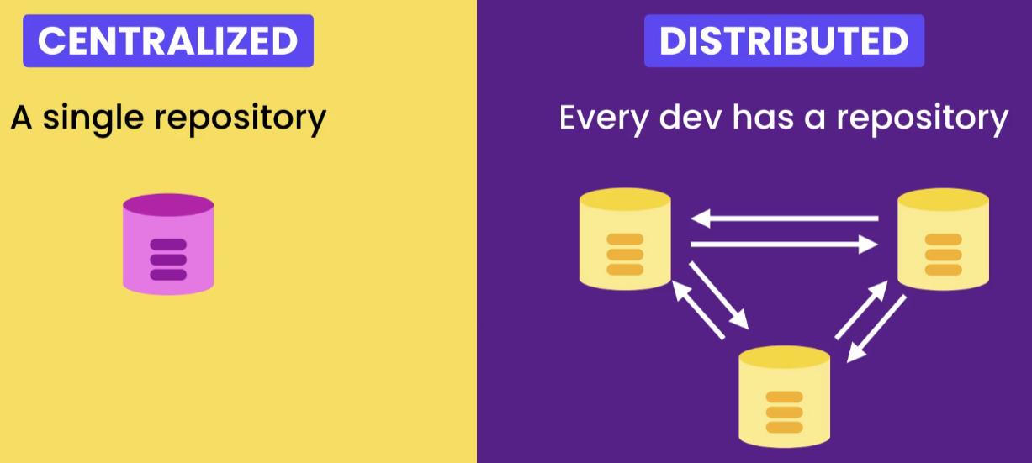
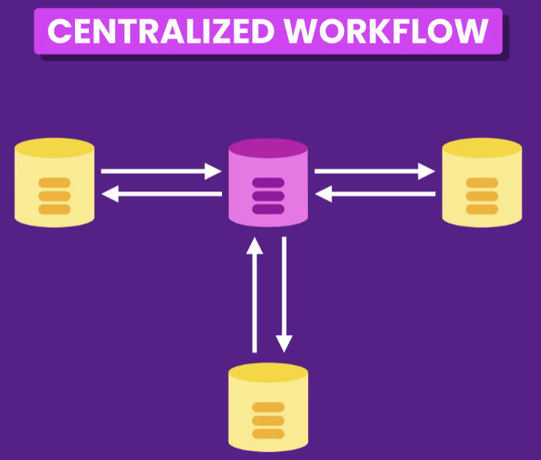
Workflows
GitHub, GitLab, etc.
Two types of VCS
Fast and no single of point of failure

Slide 4
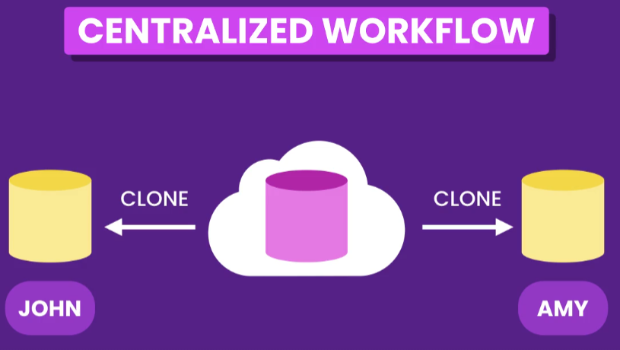
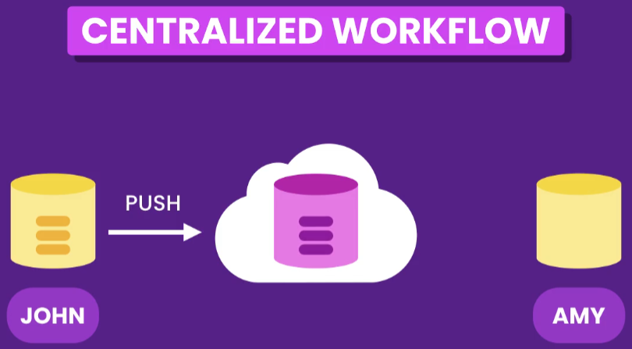
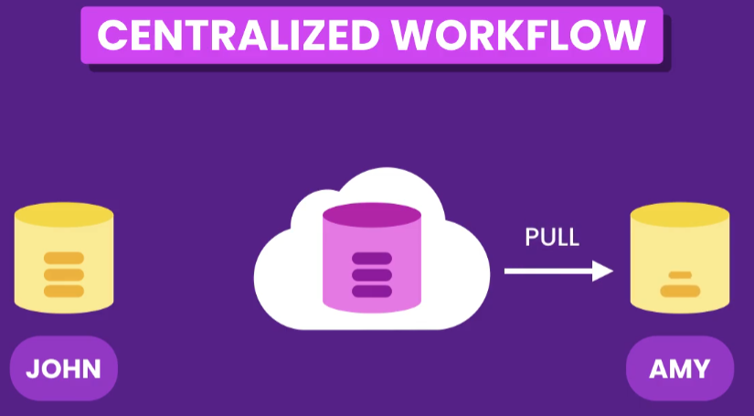
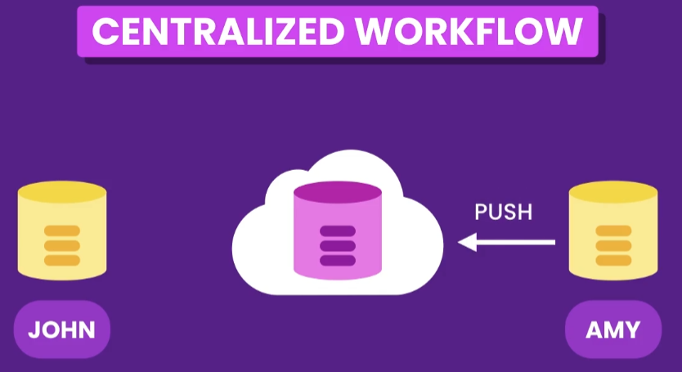
Real-World Scenario

Slide 5
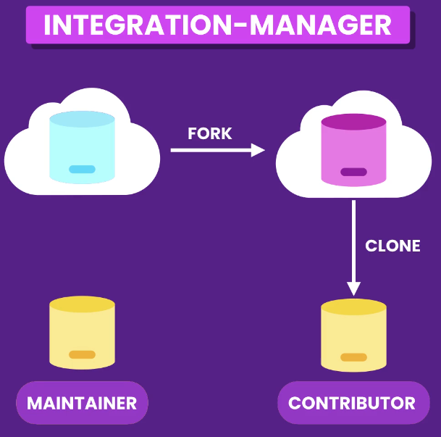
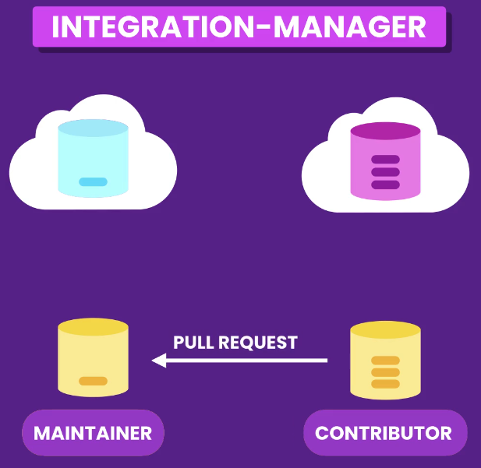
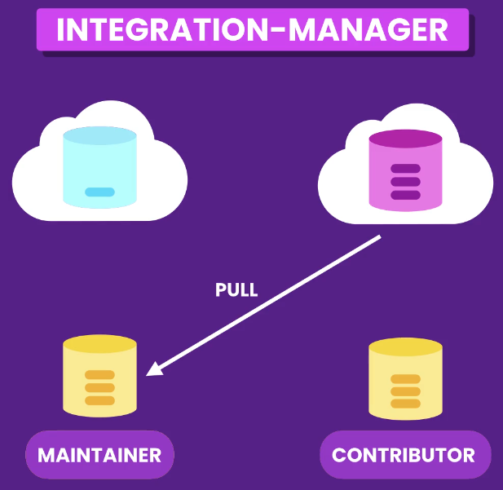
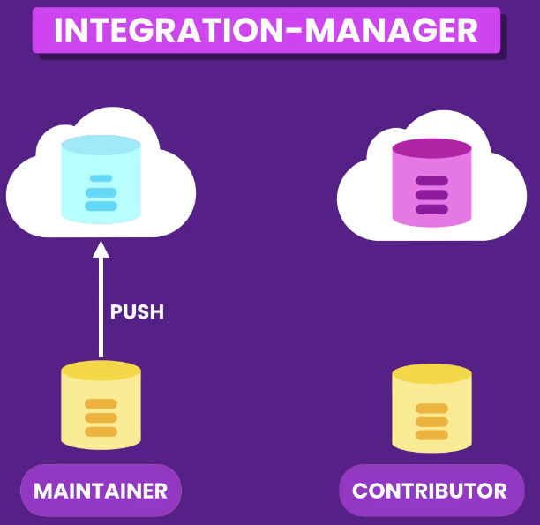

Slide 6
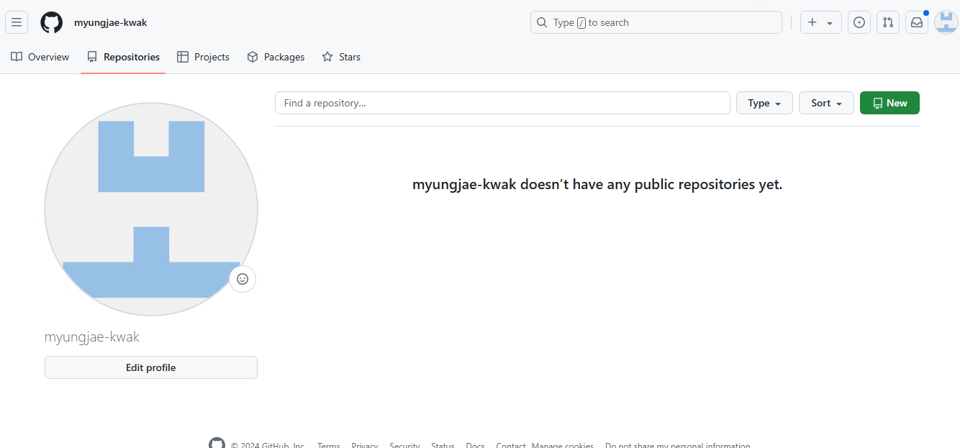
JOHN: Creating a GitHub Repository (myungjae-kwak)
Go to github.com, create an account and login

Slide 7
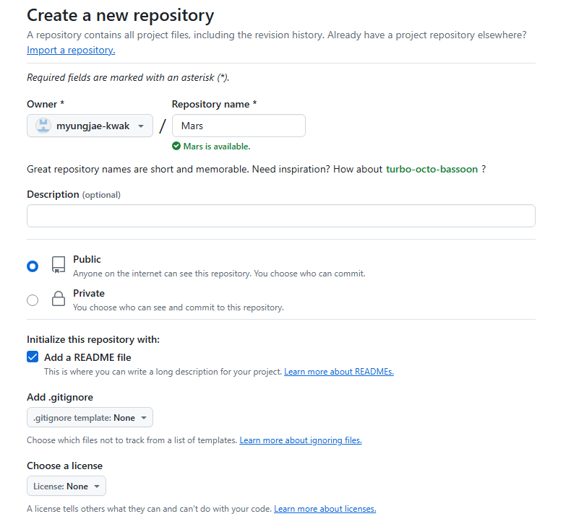
JOHN : Creating a GitHub Repository
Create a new repository named ‘Mars’
Choose ‘Public’
Check ‘Add a README file’

Slide 8
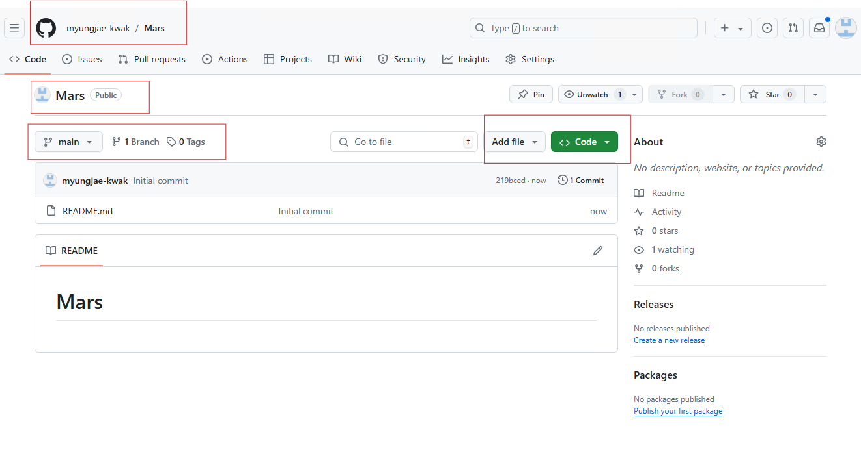

Slide 9
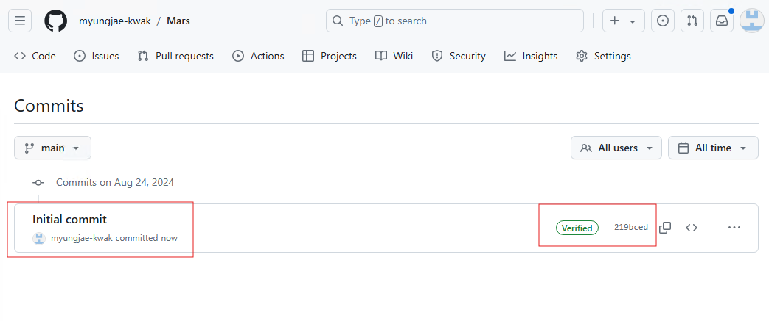

Slide 10
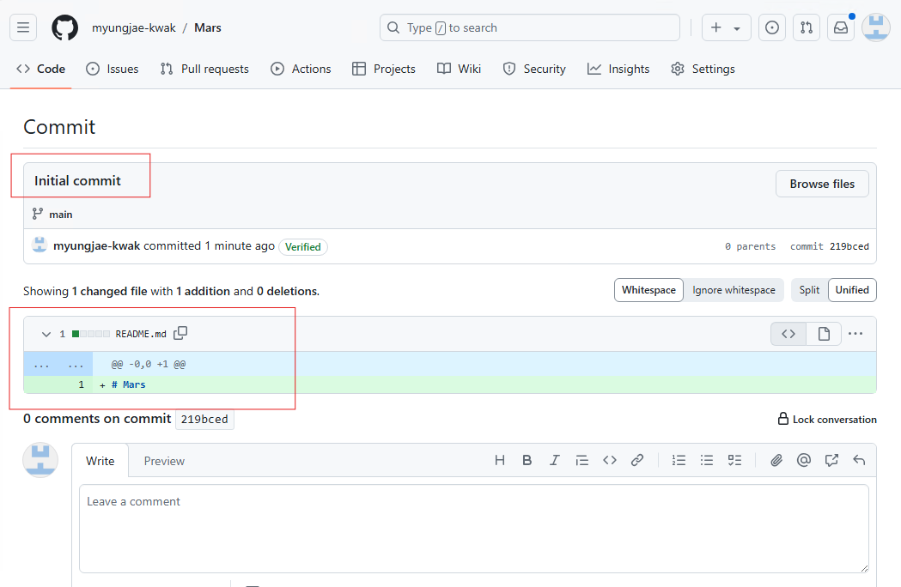

Slide 11
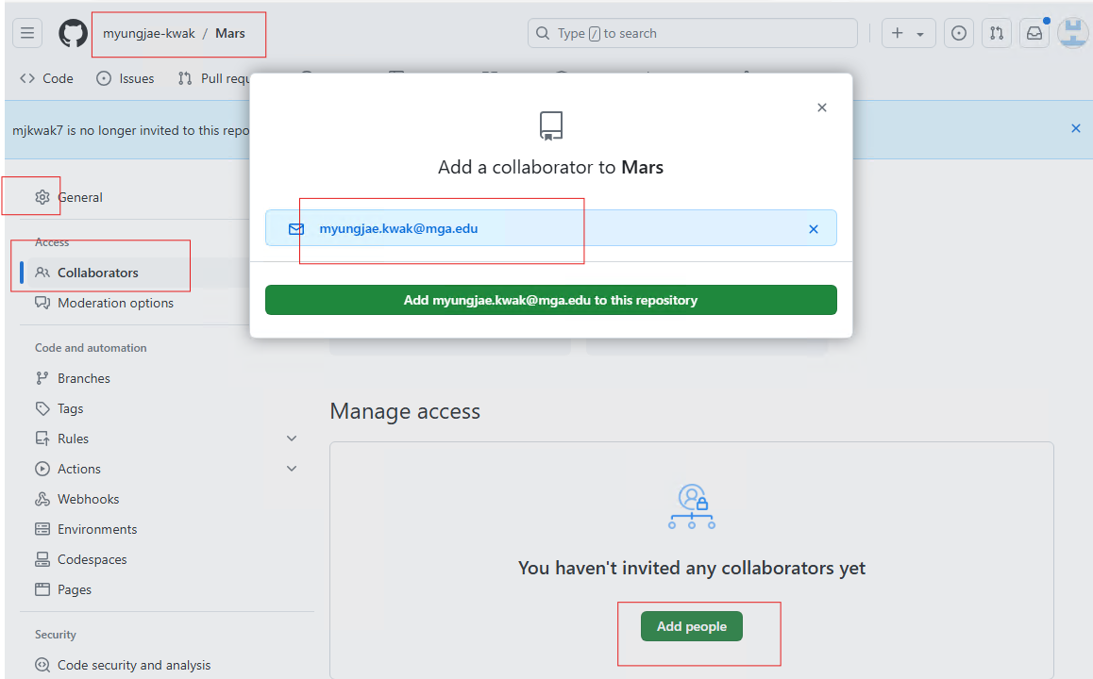
JOHN: Adding Collaborators (AMY, mkwak718)

Slide 12
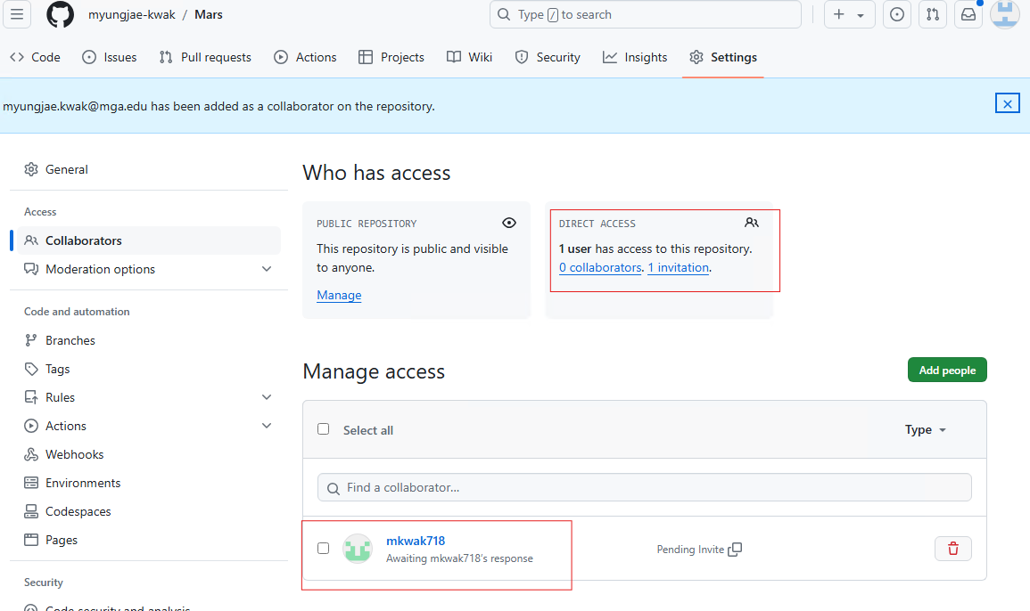

Slide 13
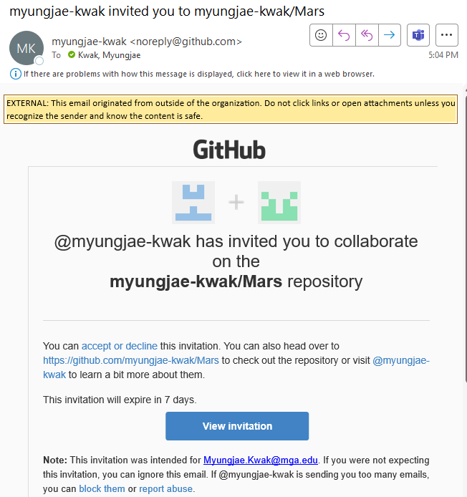
AMY: Accept the invitation

Slide 14
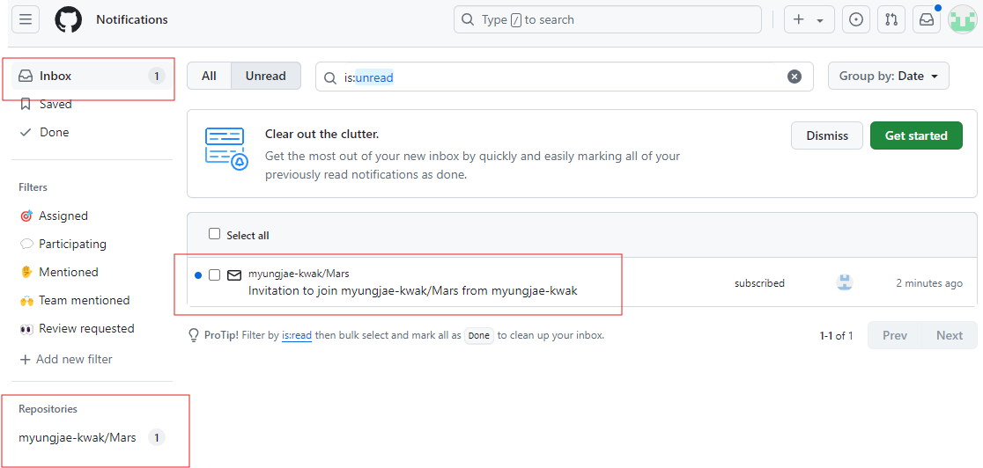
AMY: Accept the invitation

Slide 15
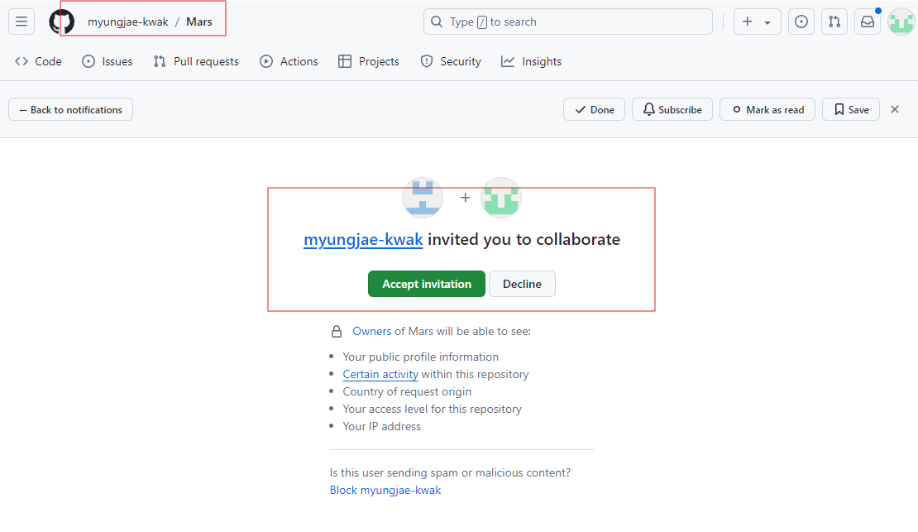

Slide 16
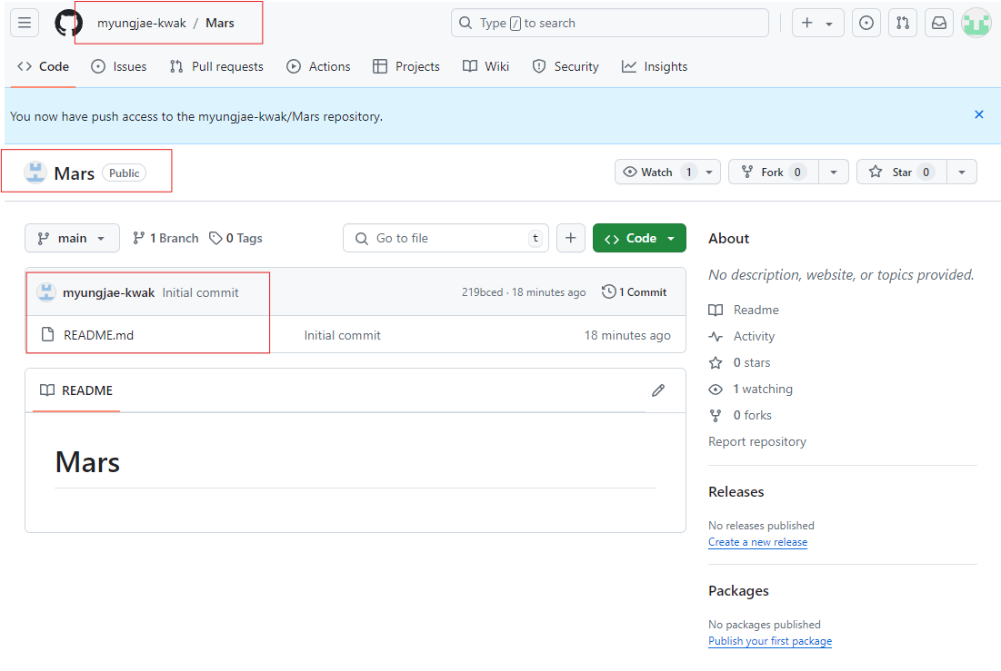
AMY: Collaborators (i.e., mkwak718) can see the same repository.

Slide 17
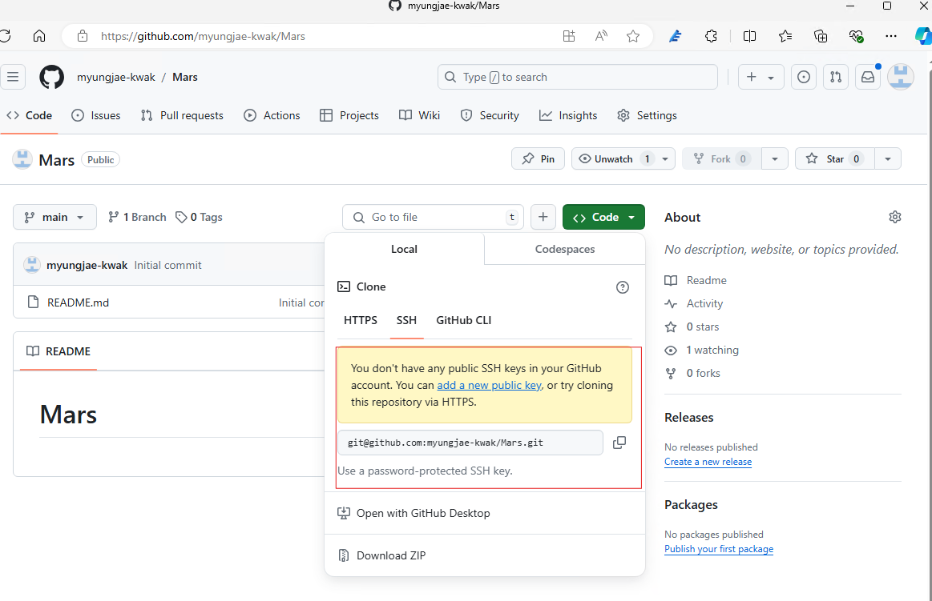
JOHN & AMY: Creating a SSH Key

Slide 18
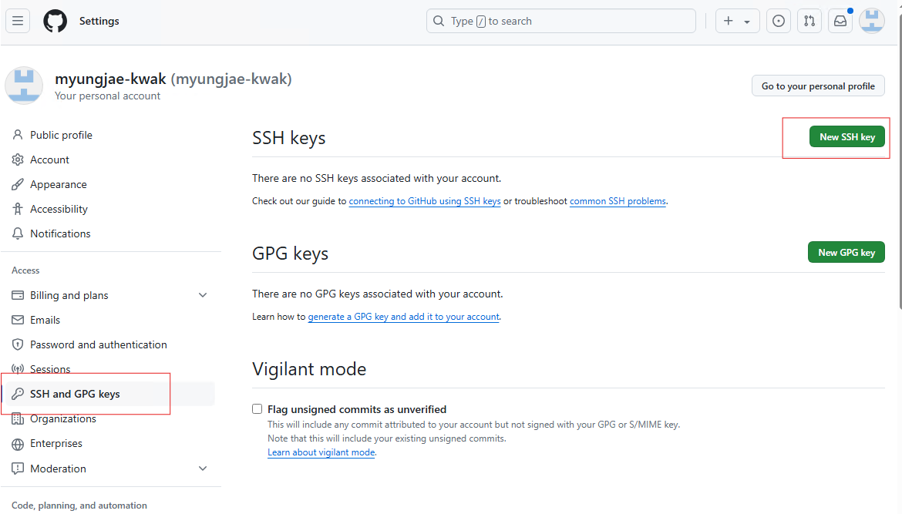
Settings -> SSH and GPG keys

Slide 19
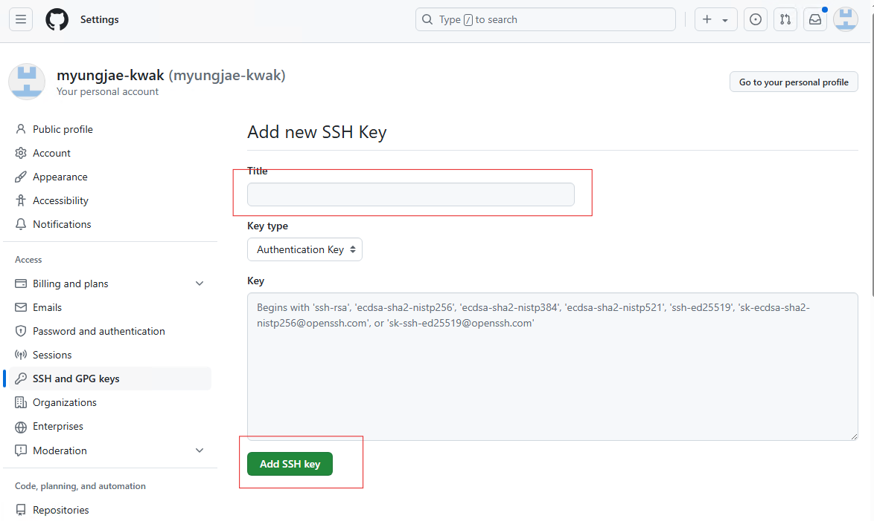

Slide 20
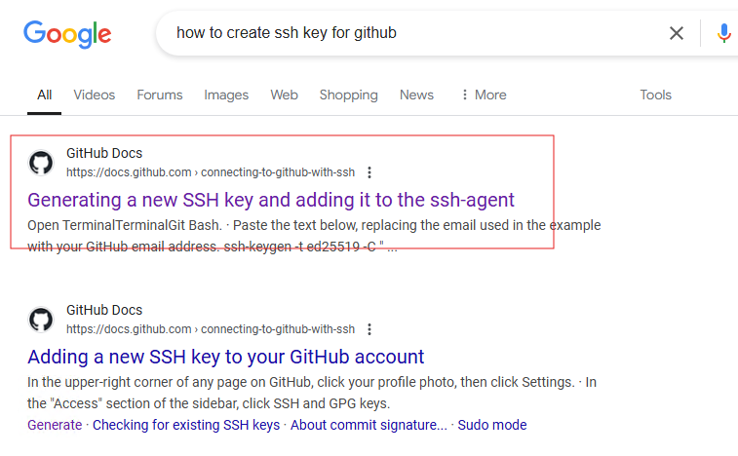
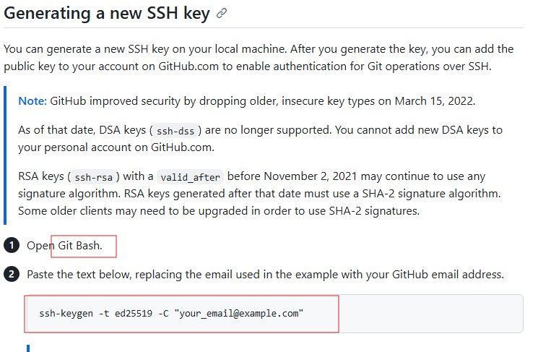

Slide 21
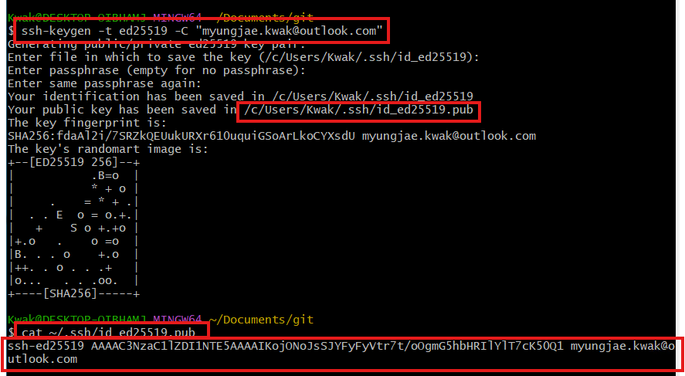

Slide 22
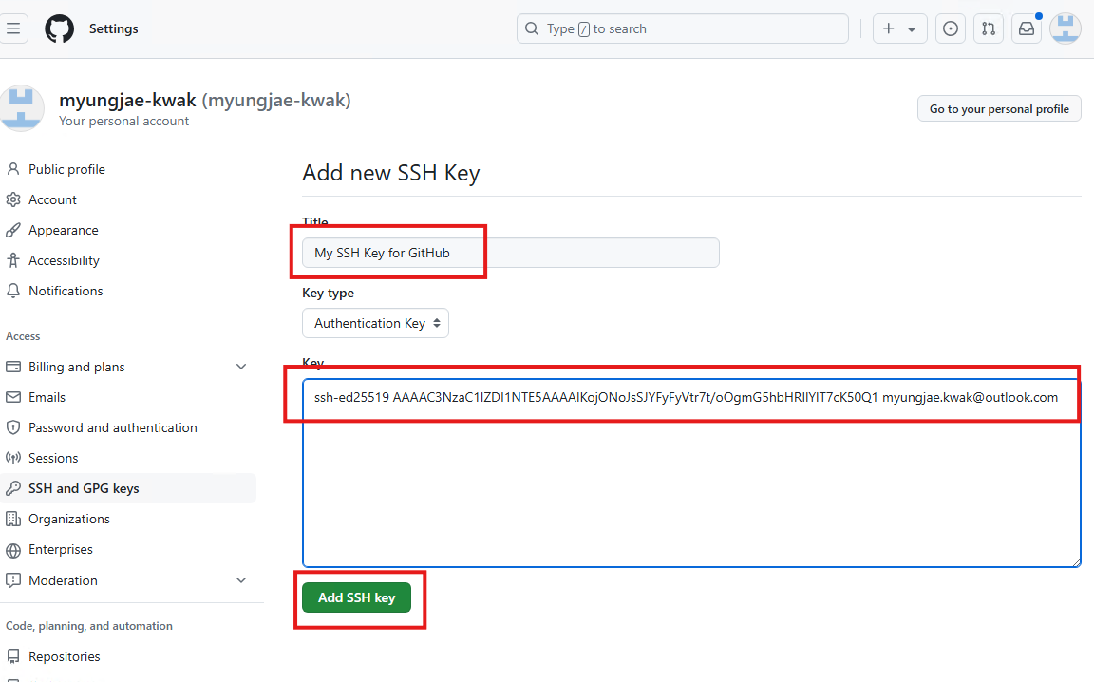

Slide 23
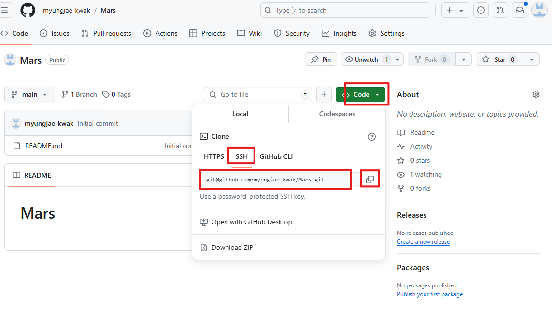
JOHN : Cloning a Repository

Slide 24
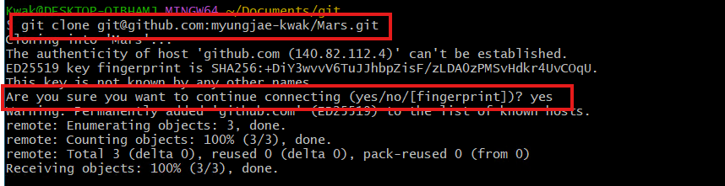
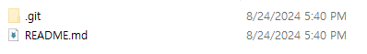

Slide 25
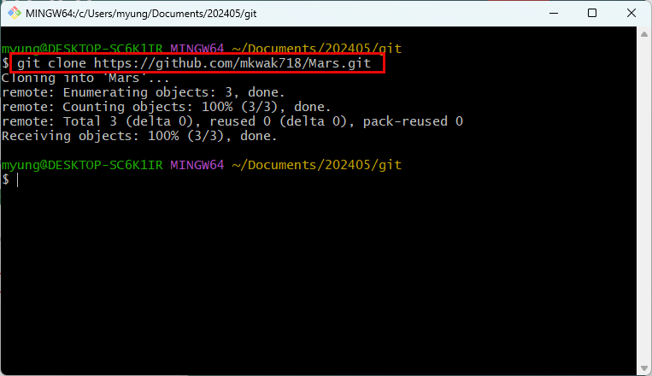
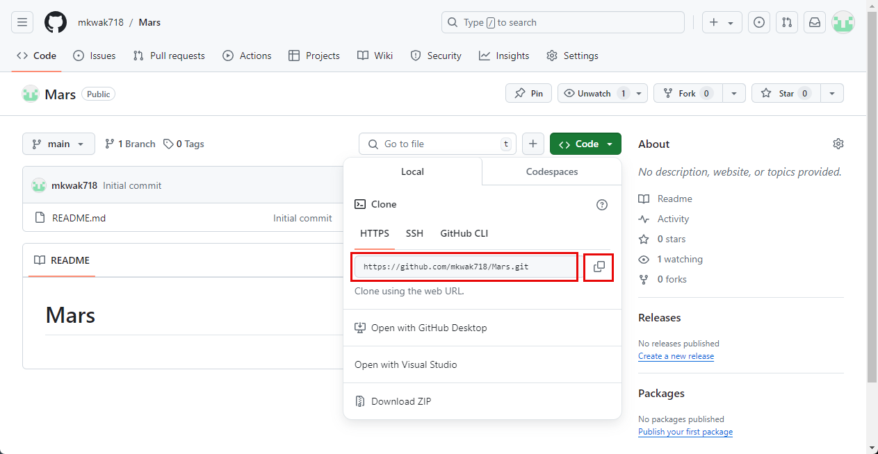
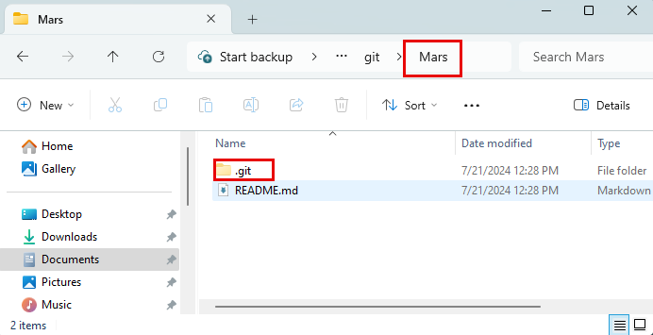
JOHN : Cloning a Repository

Slide 26
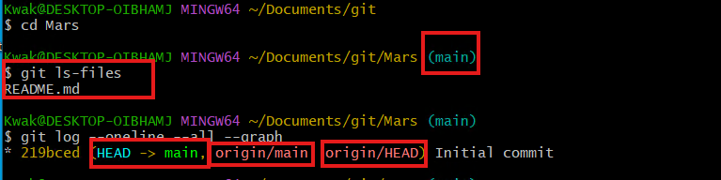
Currently there is a single commit.
‘HEAD -> main’: in the local (cloned) branch, HEAD is pointing to the main branch.
‘origin’ means remote repository.
‘origin/main’ means the local repository is referring to the main branch of remote repository.
‘origin/HEAD’ means the HEAD pointer of the origin (remote) repository is pointing to the current commit/snapshot.

Slide 27
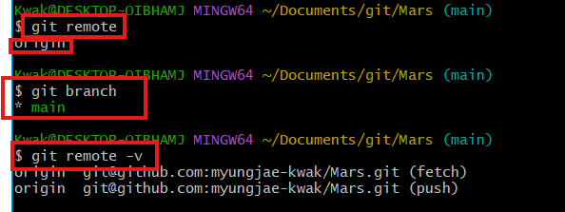
‘git remote’ shows remote repositories.
There is a single branch in local repository.

Slide 28
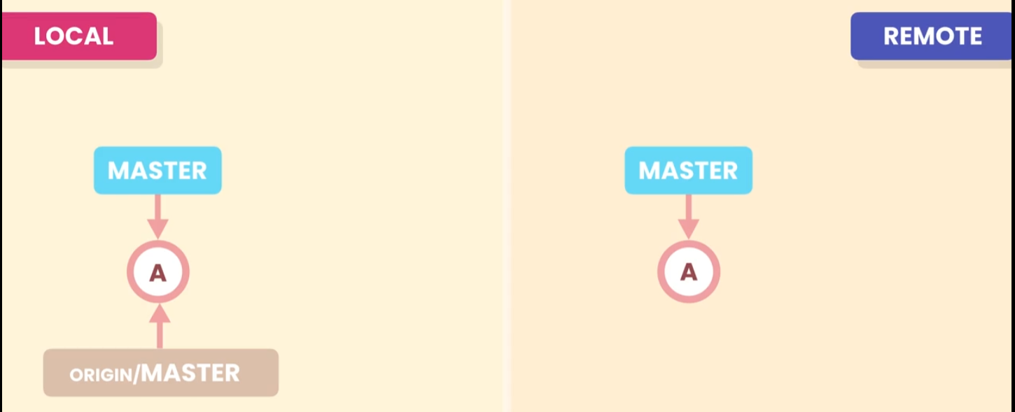
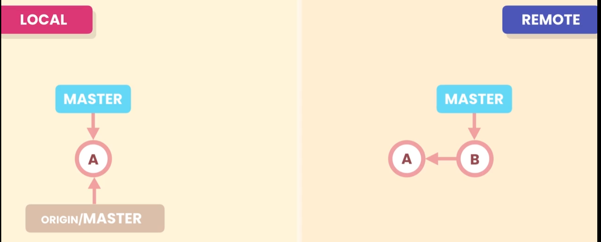
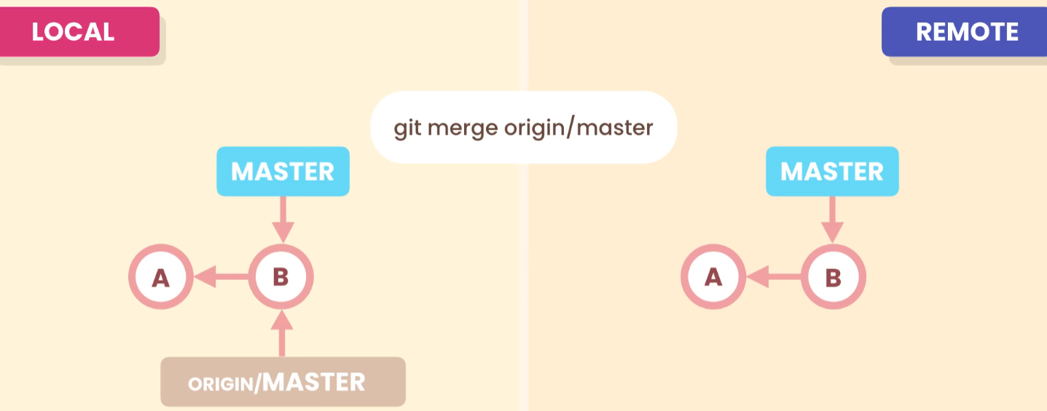
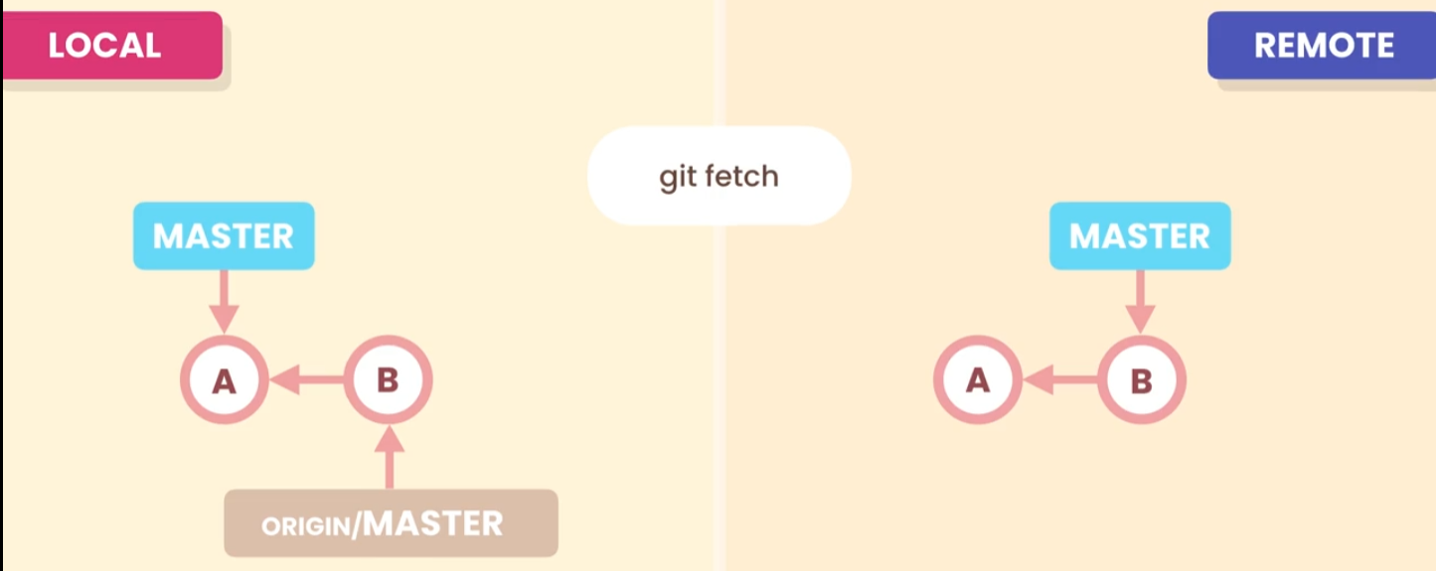
Fetching (as JOHN)
This is fast-forward merging. If there is a conflict, need to resolve it.
Working directory is not updated at this point

Slide 29
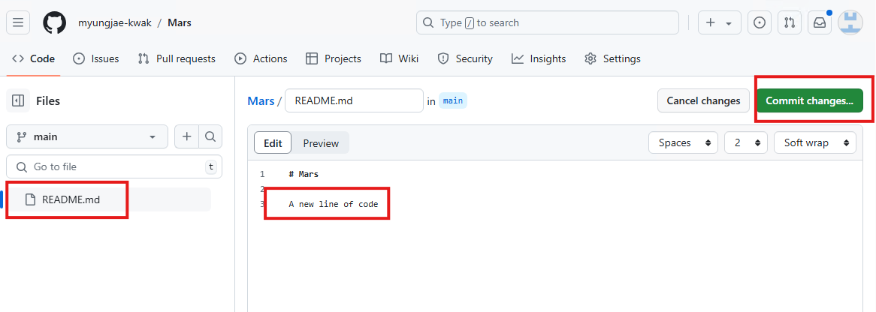
Using the web editor, modify ‘README.md’ file and commit changes.

Slide 30
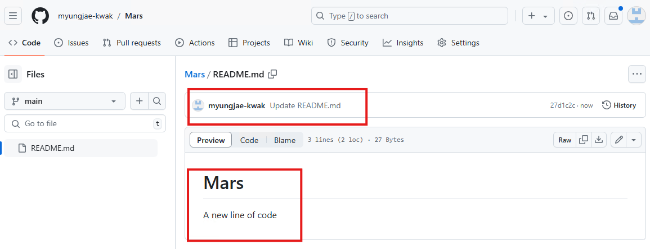
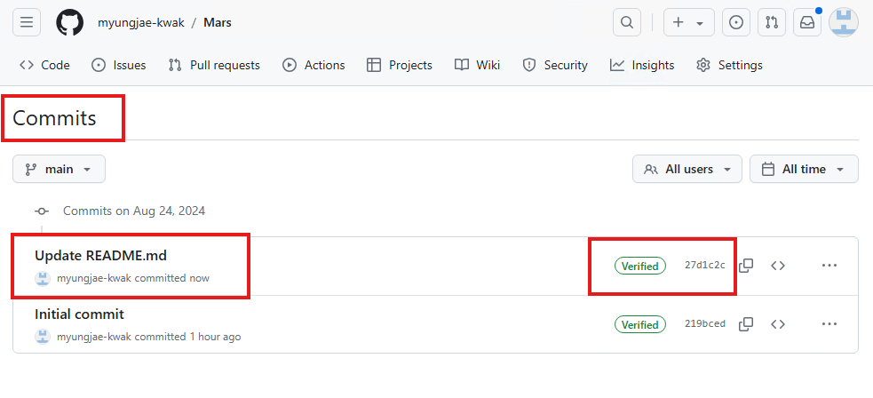

Slide 31
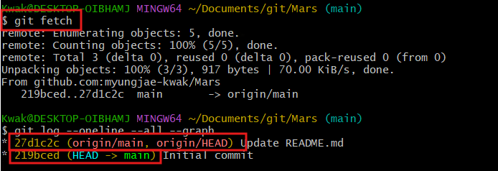
‘git fetch’ will execute ‘git fetch origin’ by default. You may specify a particular branch too.
You can see that local repository’s HEAD pointer was not updated.

Slide 32
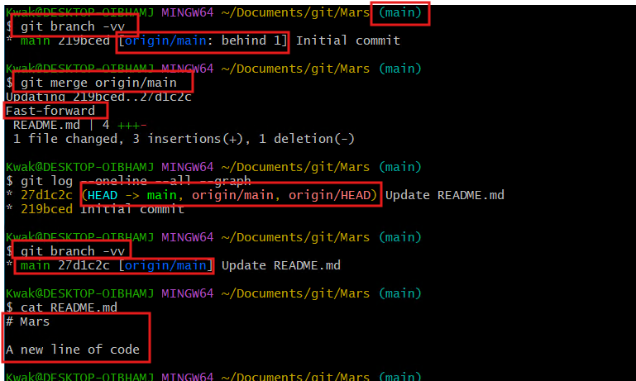
Now, you can see that local repository’s HEAD pointer was updated.

Slide 33
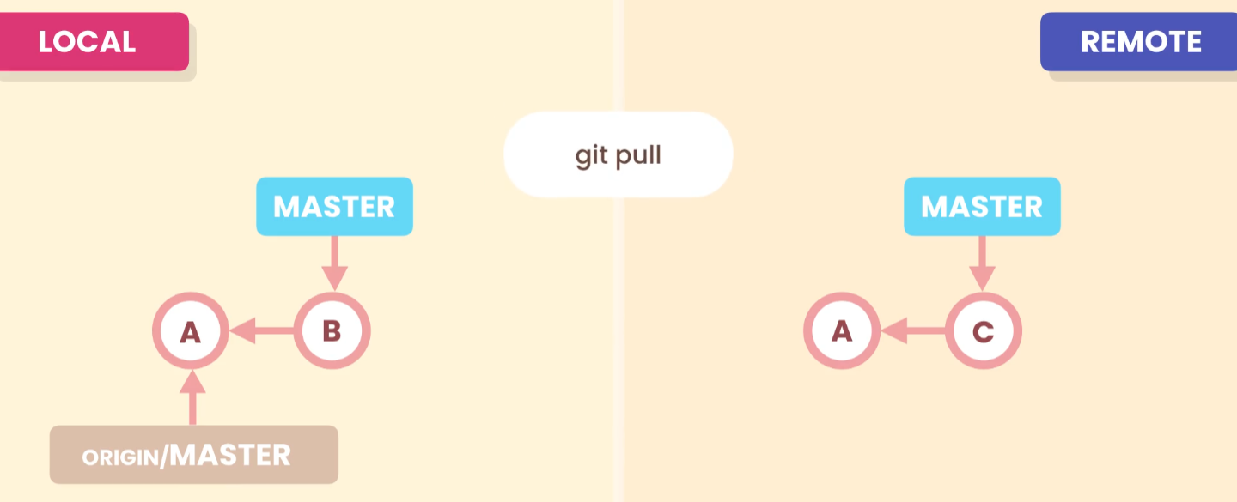
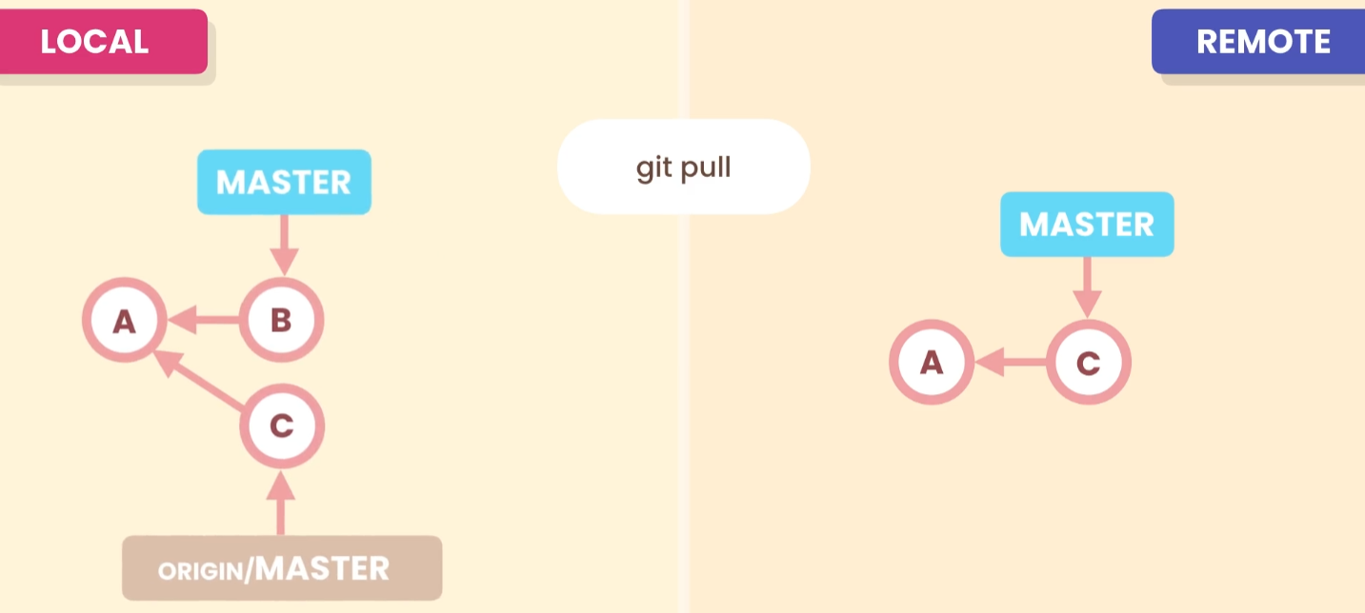
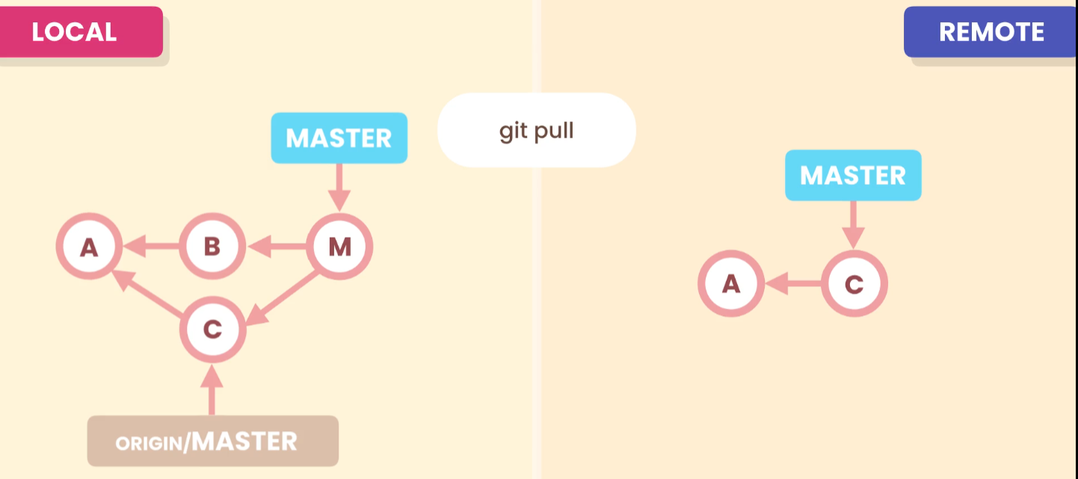
Pulling = Fetch + Merge (as JOHN)
When both remote and local repositories have a commit.
In this case, you will need to do 3-way merge.

Slide 34
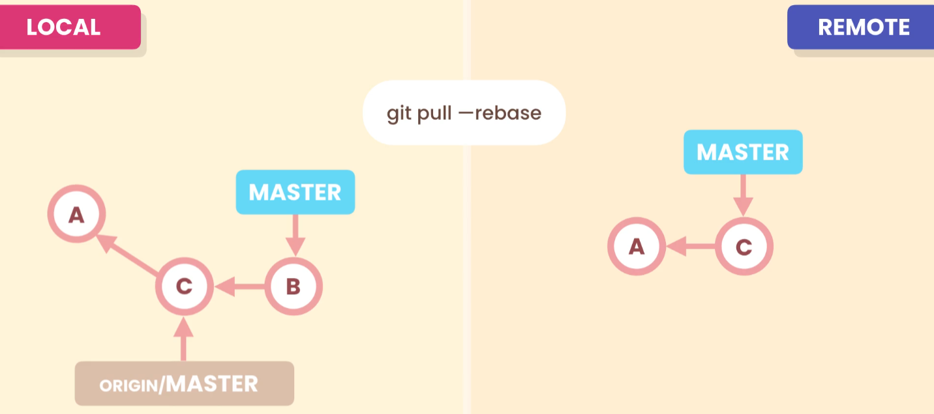
Alternatively, you can use ‘--rebase’ option. It will replace local commit on top of changes made by others and make the history linear.
Which is better?

Slide 35
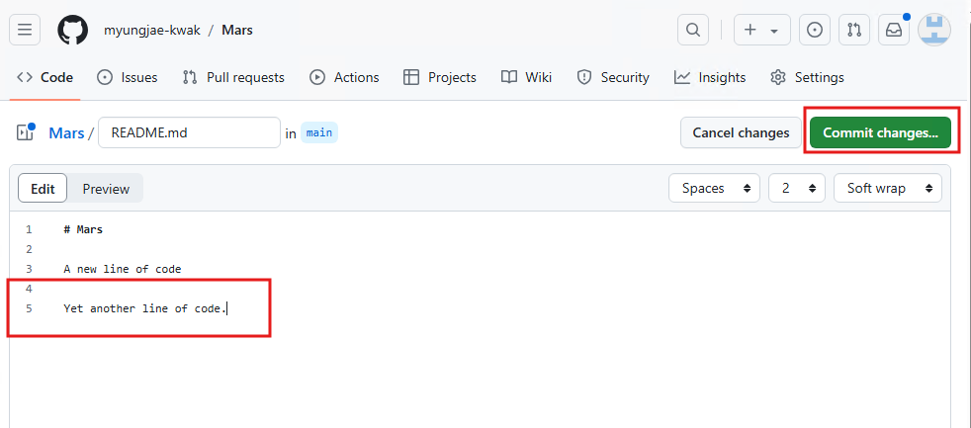

Slide 36



Slide 37

Before pulling the code from the remote, create a new file and commit it in local repository.
So, two repositories have diverged.

Slide 38

‘git pull’ command will do a 3-way merge.
If you don’t like it, you can undo the last commit, and execute ‘git pull --rebase’ command.

Slide 39

JOHN: Rebasing
If you use ‘git reset --hard HEAD~1’, it will undo the last commit and put it back to the previous state.

Slide 40

If you use ‘git pull --rebase’, it will merge and create a simple linear history.

Slide 41



JOHN: Pushing
After pulling (by using either 3-way merging or rebasing, you need to push the changes to the remote.

Slide 42

You can upload your code by using ‘git push origin main’, ‘git push origin’, or simply ‘git push’.
Now, you can see that local repositories are the same.
When you push for the first time, GitHub requires you to create a personal access token or generate ssh-key.

Slide 43


JOHN’s Repository Mars

Slide 44

Push can be rejected
When two repositories have diverged, pull request can be rejected.
In this case, you can use ‘git push –f’, but it will drop other’s work.

Slide 45


In that case,
You pull the changes to local repository and merge the changes with your code. Then you can push your code.
Then, two repositories will be identical.

Slide 46
JOHN: Sharing Tags
By default, the push command doesn’t transfer local tags to a remote repository.
So, you have to push them explicitly.

Slide 47




‘git tag v1.0’ will create a tag on the current snapshot.
If you want to push tags, you have to do it explicitly.

Slide 48


JOHN: Releases

Slide 49

The tag will be attached to the current release automatically.
You can always delete this release as needed.

Slide 50


JOHN: Delete Tags
You can delete the tag in the remote.
In that case, the tag still exists in the local repository.
You can delete it too by using ‘-d’ option.

Slide 51

Once a tag is deleted, the release will be deleted as well.

Slide 52

JOHN: Sharing Branches
When you want to create a new branch and share with others, you cannot simply push it to remote repository.

Slide 53

By using this command, you can check whether a new local branch is linked to the remote repo. In this case, it is not linked to a remote repository.
By using ‘git branch –r’, you can see all remote tracking branches.

Slide 54

You can create an upstream branch by using ‘-u’ option.

Slide 55


Slide 56

JOHN: Can delete remote branches
You can delete the ‘feature/change-password’ branch using ‘–d’ option.
But it still exists in the local repo.

Slide 57

The branch in the remote repo is gone.

Slide 58

To delete the ‘feature/change-password’ branch in the local repo,
Switch to the main branch and delete it by using ‘-d’ option.

Slide 59

Collaboration Workflow (JOHN & AMY)
JOHN: Create a new branch using the web app.

Slide 60

JOHN:

Slide 61

JOHN:
If you fetch the remote repo, it will get the new branch information, but the local branches are still not updated.
But the remote tracking branches are up-to-date.

Slide 62

JOHN:
This command will create a new branch ‘feature/change-password’ in the local repo, which is set up to track the remote ‘feature/change-password’ branch.

Slide 63

AMY:
Another team member (AMY) cloned the remote repo to work on new feature.

Slide 64

AMY:
Another team member (AMY) cloned the remote repo to work on new feature.
In his local repo, he only can see only the main branch.
So, he must create and switch to the feature/change-password branch in his local repo.

Slide 65

AMY:
AMY creates a new file in the new branch and make a commit.
Then pushes the changes.
** may have to sign in and provide your credentials.

Slide 66


AMY:
Now the push was successfully made.

Slide 67


Slide 68

JOHN:
If JOHN runs the pull command, he can see that AMY’s code was successfully merged to your local branch (in this case there is no conflict).

Slide 69

JOHN: Merging two branches
To finish the merge two branches, JOHN needs to switch to the main branch
Then merge the feature/change-password branch
JOHN can see the pointers of the remote repo are one commit behind.
So, JOHN needs to push the changes to the remote repo.

Slide 70

JOHN:
Now, pointers at both repos (JOHN’s and the remote) are pointing to the same commit.

Slide 71

JOHN:

Slide 72

JOHN:
Once JOHN is done with the feature branch, he can delete it from the remote repo.
But the feature branch is still in the local repo.
So, JOHN will need to delete it too.

Slide 73

JOHN:

Slide 74

AMY:
For AMY’s standpoint, to clean up the feature branch
She needs to switch to main,
Execute pull command to get up-to-date snapshot

Slide 75

AMY:
Delete the local feature branch
Then clear the remote tracking branches using prune command.

Slide 76

AMY:
Now, the feature branch was removed.

Slide 77

AMY: Pull Requests
Assume another team member(AMY) wants to work on a new feature…
Create a new branch
Create a new file on the branch and commit.

Slide 78

AMY:
Then push the branch.
In this case, she has to use ‘–u’ option

Slide 79

AMY:
New branch is created.

Slide 80


AMY:
If she clicks ‘Compare and uull request’, it will compare two branches and show the differences.
If there is no conflict, it will display “There branches can be automatically merged.”

Slide 81

AMY:

Slide 82


AMY:

Slide 83

AMY:
After creating pull request, ask another team member to review the merge.

Slide 84

AMY:

Slide 85

JOHN:
If the requested team member (JOHN) logs in, he will see the request and can add his review.

Slide 86

JOHN:

Slide 87

JOHN:

Slide 88

JOHN:

Slide 89

AMY:
AMY checks JOHN’s comment and changes her code.

Slide 90

AMY:
AMY makes necessary changes and pushes again.

Slide 91


AMY:
Then ask review again.

Slide 92

JOHN:
JOHN sees AMY’s review request.

Slide 93


JOHN:
JOHN approves AMY’s review request.

Slide 94

JOHN:

Slide 95


AMY:
AMY confirms JOHN’s approval.

Slide 96

Once the review process is done, AMY creates “Merge pull request”.
AMY:

Slide 97


AMY:
Merge pull request is successfully done.

Slide 98

AMY:
And delete the branch.

Slide 99

AMY:
From AMY’s computer,
Switch to main
Pull the changes
Can see the feature branch was successfully merged to main branch.
No longer need the feature branch. So, delete it.

Slide 100

AMY:
Remove the feature branch from the local repo and remote tracking branches.

Slide 101


AMY: Resolving Conflicts
AMY started a new branch to work on some other features.
So, she created a new branch named ‘feature/logout’
Added a new file.
Made a commit
Pushed to remote

Slide 102

AMY:
Therefore, new branch is created in the remote repo

Slide 103

AMY:
AMY switched to main and modify the same, file1.txt, made a commit and pushed the changes, which will create a conflict.
It is because the master and the new feature branches have diverged.
AMY wants to move forward and starts pull request

Slide 104


AMY:
When AMY makes a pull request, she will get a conflict error.

Slide 105

AMY:
AMY continues to make a pull request.

Slide 106

AMY:
Then she gets this.
So, someone needs to resolve these conflicts and merge them manually.

Slide 107



AMY:
Someone needs to resolve the conflicts and mark as resolved.

Slide 108



AMY:

Slide 109

AMY:
AMY deletes the branch after confirming merge

Slide 110

AMY:
AMY needs to pull again and removes the feature branch from local and remote tracking branches

Slide 111
Summary

Slide 112
Exercises
# app.py
from flask import Flask
app = Flask(__name__)
@app.route("/")
def hello_world():
return "<h1>Starter Flask App</h1>"
if __name__ == '__main__':
app.run(debug=True, host='0.0.0.0', port=8080)

Slide 113
Exercises
# app.py
from flask import Flask
from markupsafe import escape
app = Flask(__name__)
@app.route("/")
def hello_world():
return "<h1>Starter Flask App</h1>“
@app.route("/<name>")
def hello(name):
return f"Hello, {escape(name)}!"
if __name__ == '__main__':
app.run(debug=True, host='0.0.0.0', port=8080)

